Slide 1
Understanding the CSS Box Model and Positioning

Slide 2
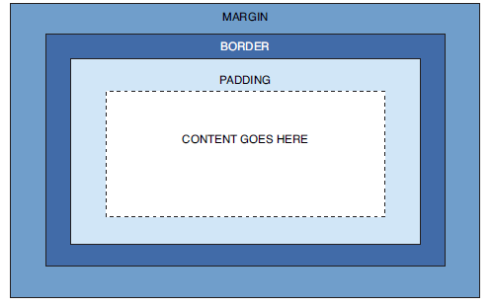
The CSS Box Model
Every element in HTML is considered a “box,” whether it is a paragraph, a <div>, an image, or so on.
Boxes have consistent properties, whether we see them or not, and whether they are specified at all in the style sheet or not.
They’re always present, and as designers, we have to keep their presence in mind when creating a layout.
Figure: Every element in HTML represented by the CSS box model.

Slide 3
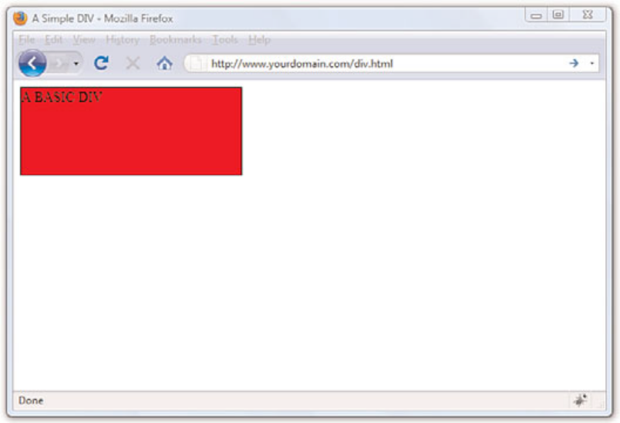
The CSS Box Model Cont..
Here’s yet another explanation of the box model, going from the outside inward:
The margin is the area outside of the element. It never has color; it is always transparent.
. The border extends around the element, on the outer edge of any padding.
The border can be of several types, widths, and colors.
The padding exists around the content and inherits the background color of the content area.
The content is surrounded by padding.
div {
width: 250px;
height: 100px;
background-color: #ff0000;
border: 1px solid #000000;
}

Slide 4
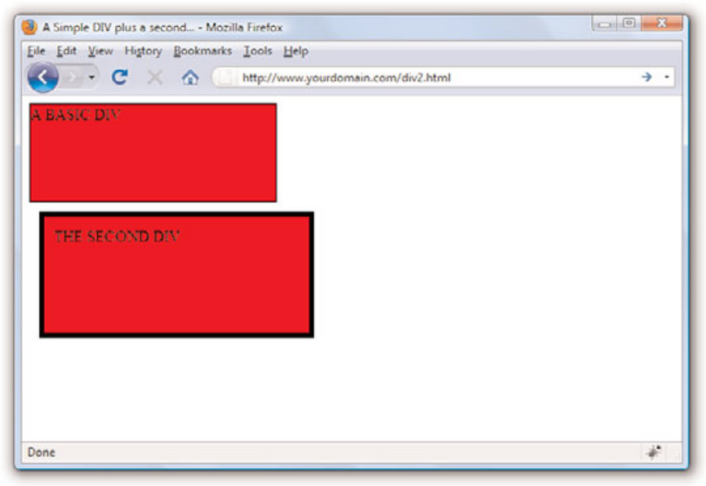
The CSS Box Model Cont..
div#d2 {
width: 250px;
height: 100px;
background-color: #ff0000;
border: 5px solid #000000;
margin: 10px;
padding: 10px;
}
The second <div>, shown in Figure, is defined as the same height and width as the first one, but the overall height and width of the entire box surrounding the element itself is much larger when margins and padding are put in play.

Slide 5
The CSS Box Model Cont..
The total width of an element is the sum of the following:
width + padding-left + padding-right + border-left + border-right + margin-left + margin-right
The total height of an element is the sum of the following:
height + padding-top + padding-bottom + border-top + border-bottom + margin-top + margin-bottom
Therefore, the second <div> has an actual width of 300
(250 + 10 + 10 + 5 + 5 + 10 + 10) and an actual height of 150 (100 + 10 + 10 + 5 + 5 + 10 + 10).

Slide 6
The Whole Scoop on Positioning
Relative positioning is the default type of positioning used by HTML.
You can think of relative positioning as being akin to laying out checkers on a checkerboard: The checkers are arranged from left to right, and when you get to the edge of the board, you move on to the next row.
Elements that are styled with the block value for the display style property are automatically placed on a new row, whereas inline elements are placed on the same row immediately next to the element preceding them.
As an example, <p> and <div> tags are considered block elements, whereas the <span> tag is considered an inline element.
The other type of positioning supported by CSS is known as absolute positioning because it enables you to set the exact position of HTML content on a page.
Although absolute positioning gives you the freedom to spell out exactly where an element is to appear, the position is still relative to any parent elements that appear on the page.

Slide 7
The Whole Scoop on Positioning Cont..
After specifying the type of positioning, you then provide the specific position using the following properties:
left—The left position offset
right—The right position offset
top—The top position offset
bottom—The bottom position offset

Slide 8
Showing Relative Positioning with Four Color Blocks
<html xmlns=”http://www.w3.org/1999/xhtml” xml:lang=”en”>
<head>
<title>Positioning the Color Blocks</title>
<style type=”text/css”>
div {
position:relative;
width:250px;
height:100px;
border:5px solid #000;
color:black;
font-weight:bold;
text-align:center;
}
div#d1 {
background-color:red;
}
div#d2 {
background-color:green;
}
div#d3 {
background-color:blue;
}
div#d4 {
background-color:yellow;
}
</style>
</head>
<body>
<div id=”d1”>DIV #1</div>
<div id=”d2”>DIV #2</div>
<div id=”d3”>DIV #3</div>
<div id=”d4”>DIV #4</div>
</body>
</html>

Slide 9
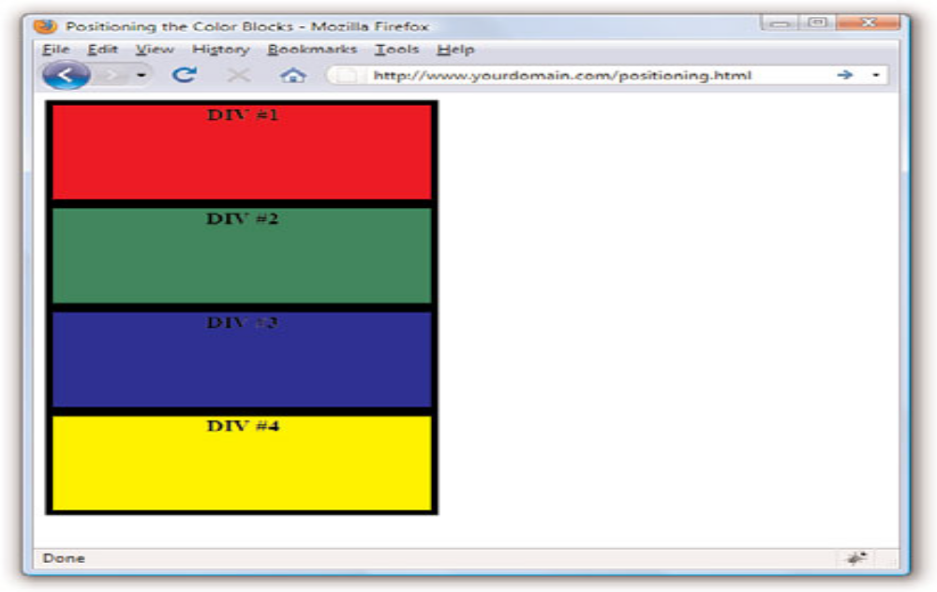
Showing Relative Positioning with Four Color Blocks

Slide 10
Using Absolute Positioning of the Color Blocks
<html xmlns=”http://www.w3.org/1999/xhtml” xml:lang=”en”>
<head>
<title>Positioning the Color Blocks</title>
<style type=”text/css”>
div {
position:absolute;
width:250px;
height:100px;
border:5px solid #000;
color:black;
font-weight:bold;
text-align:center;
}
div#d1 {
background-color:red;
left:0px;
toppx;
}
div#d2 {
background-color:green;
left:75px;
top:25px;
}
div#d3 {
background-color:blue;
left:150px;
top:50px;
}
div#d4 {
background-color:yellow;
left:225px;
top:75px;
}
</style>
</head>
<body>
<div id=”d1”>DIV #1</div>
<div id=”d2”>DIV #2</div>
<div id=”d3”>DIV #3</div>
<div id=”d4”>DIV #4</div>
</body>
</html>

Slide 11
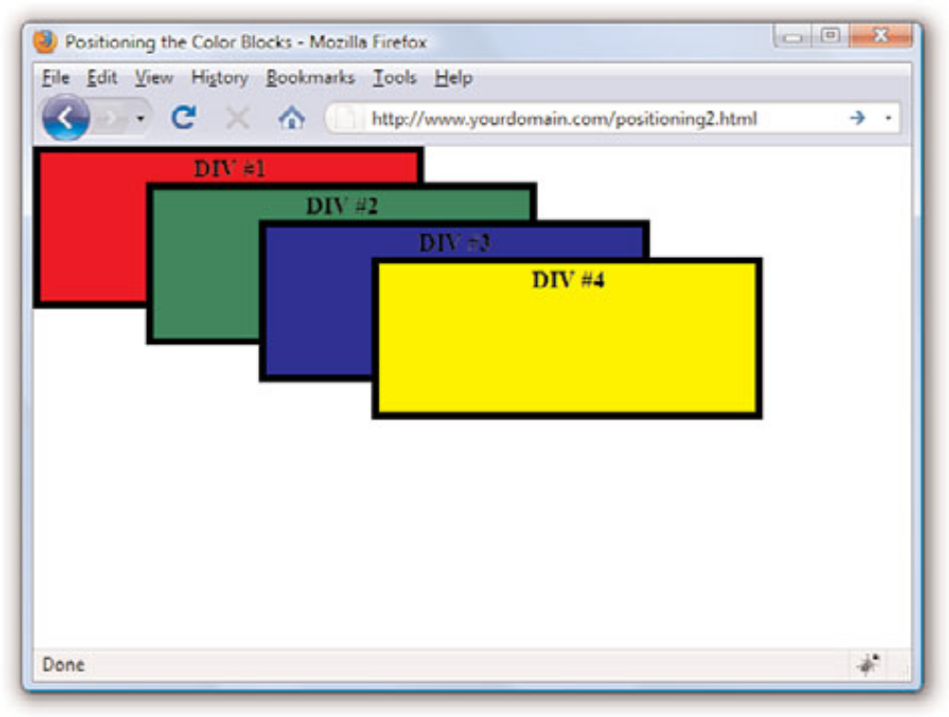
Using Absolute Positioning of the Color Blocks

Slide 12
Controlling the Way Things Stack Up
There are situations in which you’d like to carefully control the manner in which elements overlap each other on a web page.
The z-index style property enables you to set the order of elements with respect to how they stack on top of each other.
Although the name z-index might sound a little strange, it refers to the notion of a third dimension (Z) that points into the computer screen, in addition to the two dimensions that go across (X) and down (Y) the screen.
Another way to think of the z-index is the relative position of a single magazine within a stack of magazines.
The z-index property is used to set a numeric value that indicates the relative z-index of a style rule.
The number assigned to z-index has meaning only with respect to other style rules in a style sheet, which means that setting the z-index property for a single rule doesn’t mean much.

Slide 13
Using z-index to Alter the Display of Elements in the Color Blocks Sample
<html xmlns=”http://www.w3.org/1999/xhtml” xml:lang=”en”>
<head>
<title>Positioning the Color Blocks</title>
<style type=”text/css”>
div {
position:absolute;
width:250px;
height:100px;
border:5px solid #000;
color:black;
font-weight:bold;
text-align:center;
}
div#d1 {
background-color:red;
left:0px;
top:0px;
z-index:0;
}
div#d2 {
background-color:green; left:75px; top:25px; z-index:3;
}
div#d3 {
background-color:blue;
left:150px;
top:50px;
z-index:2;
}
div#d4 {
background-color:yellow;
left:225px;
top:75px;
z-index:1;
}
</style>
</head>
<body>
<div id=”d1”>DIV #1</div>
<div id=”d2”>DIV #2</div>
<div id=”d3”>DIV #3</div>
<div id=”d4”>DIV #4</div>
</body>
</html>

Slide 14
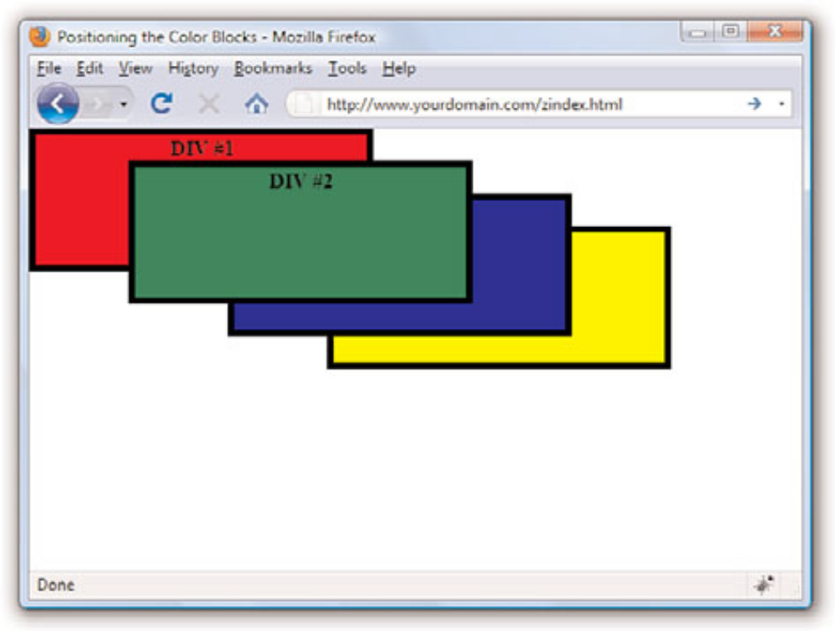
Using z-index to Alter the Display of Elements in the Color Blocks Sample

Slide 15
Managing the Flow of Text
The float property is used to control how text flows around an element.
It can be set to either left or right. These values determine where to position an element with respect to flowing text.
So, setting an image’s float property to left positions the image to the left of flowing text.
Some style properties that provide you with control over text flow:
float—Determines how text flows around an element
clear—Stops the flow of text around an element
overflow—Controls the overflow of text when an element is too small to contain all the text

Slide 16
RESPONSIVE WEB DESIGN
In 2016, mobile internet usage surpassed desktop usage—an important milestone. The percentage of web traffic that comes from devices other than desktop browsers is steadily increasing.
A smartphone or tablet is their only access to the internet because of lack of access to a computer or high-speed WiFi at work or home.
* Younger users may be mobile-only by choice. Furthermore, the vast majority of us access the web from a number of platforms (phone, tablet, computer) over the course of the day That’s where RWD fits in.
With one source, you ensure that mobile visitors receive the same content as other visitors (although it might be organized differently).
Users are not penalized with stripped-down content or features just because they are using a smartphone. And for visitors who might start using your site on one device and finish it on another, you can ensure a consistent experience.

Slide 17
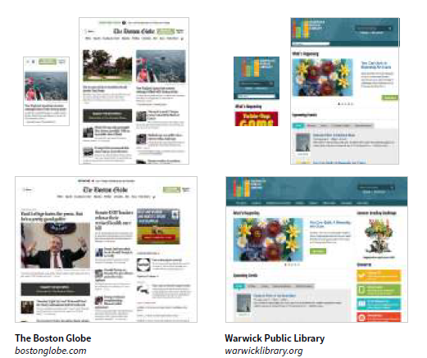
RESPONSIVE WEB DESIGN Cont..

Slide 18
THE RESPONSIVE RECIPE
The deluge of web-enabled mobile devices initially sent shockwaves through the web design community.
Accustomed to designing exclusively for large desktop screens, we were unclear about how we could accommodate screens that fit in the palm of your hand.
One solution was to rely on the phone’s built-in web display functionality.
By default, mobile devices display an entire web page shrunken down to fit on whatever screen real estate is available.
Users can pinch to zoom into the details and scroll around to various parts of the page.
While that technically works, it is far from an optimal experience.
Another approach was to create a separate mobile site just for small screens and people “on the go.”
There are still many companies and services that use dedicated mobile (“m-dot”) sites.

Slide 19
The technique has three core components:
A flexible grid
Rather than remaining at a static width, responsive sites use methods that allow them to squeeze and flow into the available browser space.
Flexible images
Images and other embedded media need to be able to scale to fit their containing elements.
CSS media queries
Media queries give us a way to deliver sets of rules only to devices that meet certain criteria, such as width and orientation.

Slide 20
Setting the Viewport
To fit standard websites onto small screens, mobile browsers render the page on a canvas called the viewport and then shrink that viewport down to fit the width of the screen (device width).
Mobile Safari introduced the viewport meta element, which allows us to define the size of that initial viewport. Soon, the other mobile browsers followed suit.
The following meta element, which goes in the head of the HTML document, tells the browser to set the width of the viewport equal to the width of the device screen (width=device-width), whatever that happens to be (FIGURE).
The initial-scale value sets the zoom level to 1 (100%).
<meta name="viewport" content="width=device-width, initial-scale=1">
With the viewport meta element in place, if the device’s screen is 320 pixels wide, the rendering viewport on that device will also be 320 pixels across (not 980) and will appear on the screen at full size.
That is the width we test for with media queries, so setting the viewport is a crucial first step.

Slide 21
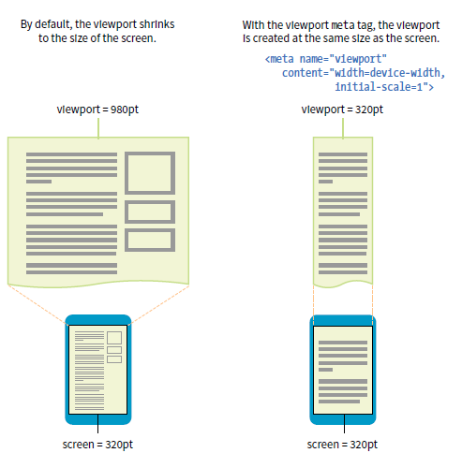

Slide 22
Flexible Grids (Fluid Layouts)
That fluidity is exactly the sort of behavior you need to make content neatly fit a wide range of viewport sizes.
Fluid layouts (or “flexible grids,” as Ethan Marcotte calls them in his article and book) are the foundation of responsive design.
In a fluid layout, the page area and its grid resize proportionally to fill the available width of the screen or window (FIGURE, top).
That is easily accomplished with fr and minmax() units in CSS Grid layouts and with flex property settings in Flexbox.
If you need to also target older browsers that don’t support CSS layout standards, you can use percentage values for horizontal measurements so elements remain proportional at varying sizes

Slide 23
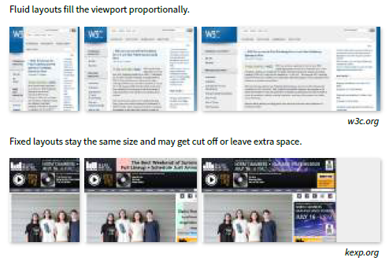
Flexible Grids (Fluid Layouts) Cont..

Slide 24
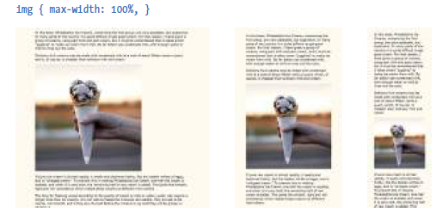
Making Images Flexible
Every now and then a solution is simple. Take, for example, the style rule required to make images scale down to fit the size of their container:
img {
max-width: 100%;
}
That’s it!

Slide 25
Media Query Magic
Media queries apply different styles based on characteristics of the browser: its width, whether it is vertically or horizontally oriented, its resolution, and more.
They are what make it possible to send a one-column layout to small screens and a multicolumn layout to larger screens on the fly.
The query itself includes a media type followed by a particular feature and a value for which to test.
The criteria are followed by a set of curly brackets that contain styles to apply if the test is passed.
The structure of a media query as used within a style sheet goes like this:
@media type and (feature: value) { /* styles for browsers that meet this criteria */ }
This isn’t a very practical design choice, but it does provide a very simple illustration of media queries at work.
@media screen and (orientation: landscape) {
body { background: skyblue; }
}
@media screen and (orientation: portrait) { body { background: coral; } } }

